Slide 1
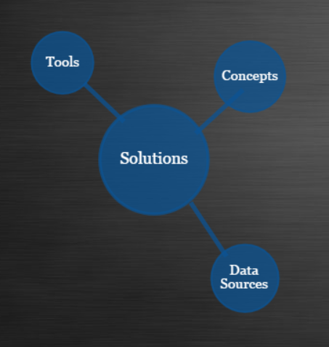
Conceptual Site Model

Slide 2
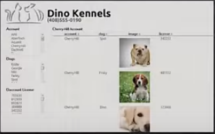
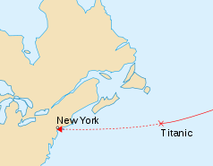


1. Solutions
Solutions
Description
Author
Data
Project Experience
Title
Tools
Image
Concepts
…
Case Studies
On Ramps
R Titanic
Tutorial
R
Stat. Modelling
Machine Learning
Contributions
Difficulty
beginner
advanced
expert
IVMOOC
Final Report
Python
MSTR
Data Engineering
Data Mining
Format
ELearning
Document
BDOSSP
Final Report
Hadoop
Spark
Video
Data Engineering
Link
s
Link
s

Slide 3
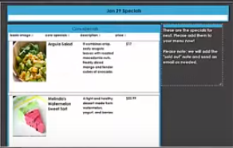

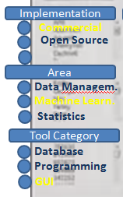

2. Tools
FILTERS
Homepage
Description
When to use
W. not to use

Slide 4
ALTERNATIVE PAGE DESIGNS

Slide 5
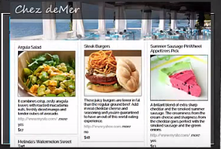

Slide 6
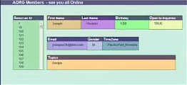

Slide 7
